Slide 1
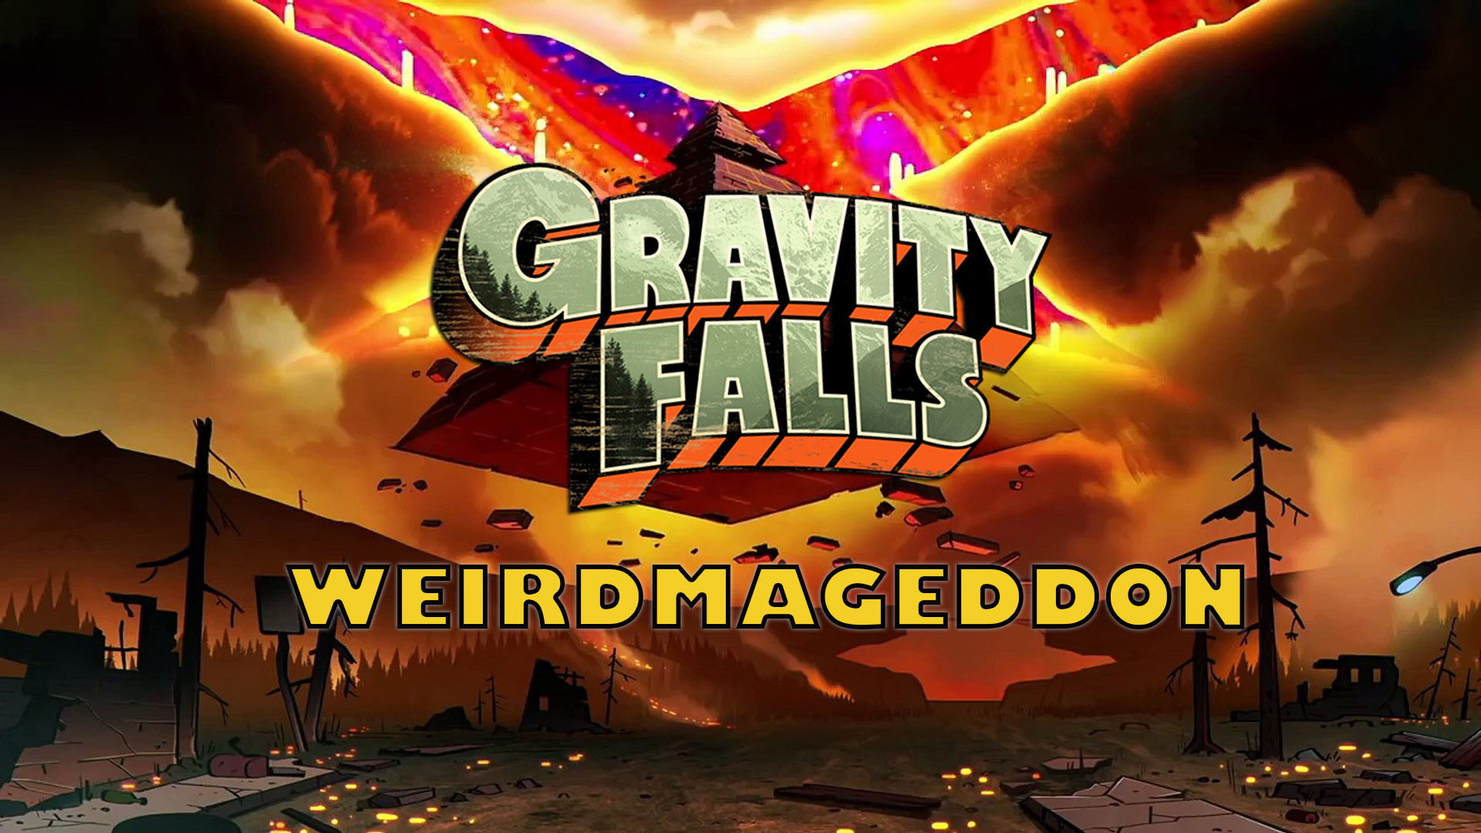

Slide 2
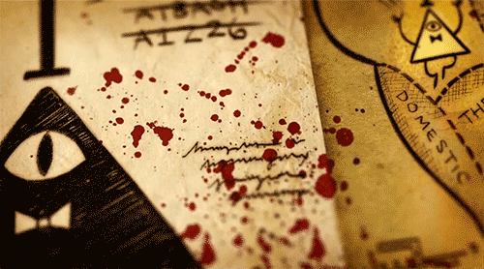

Slide 3
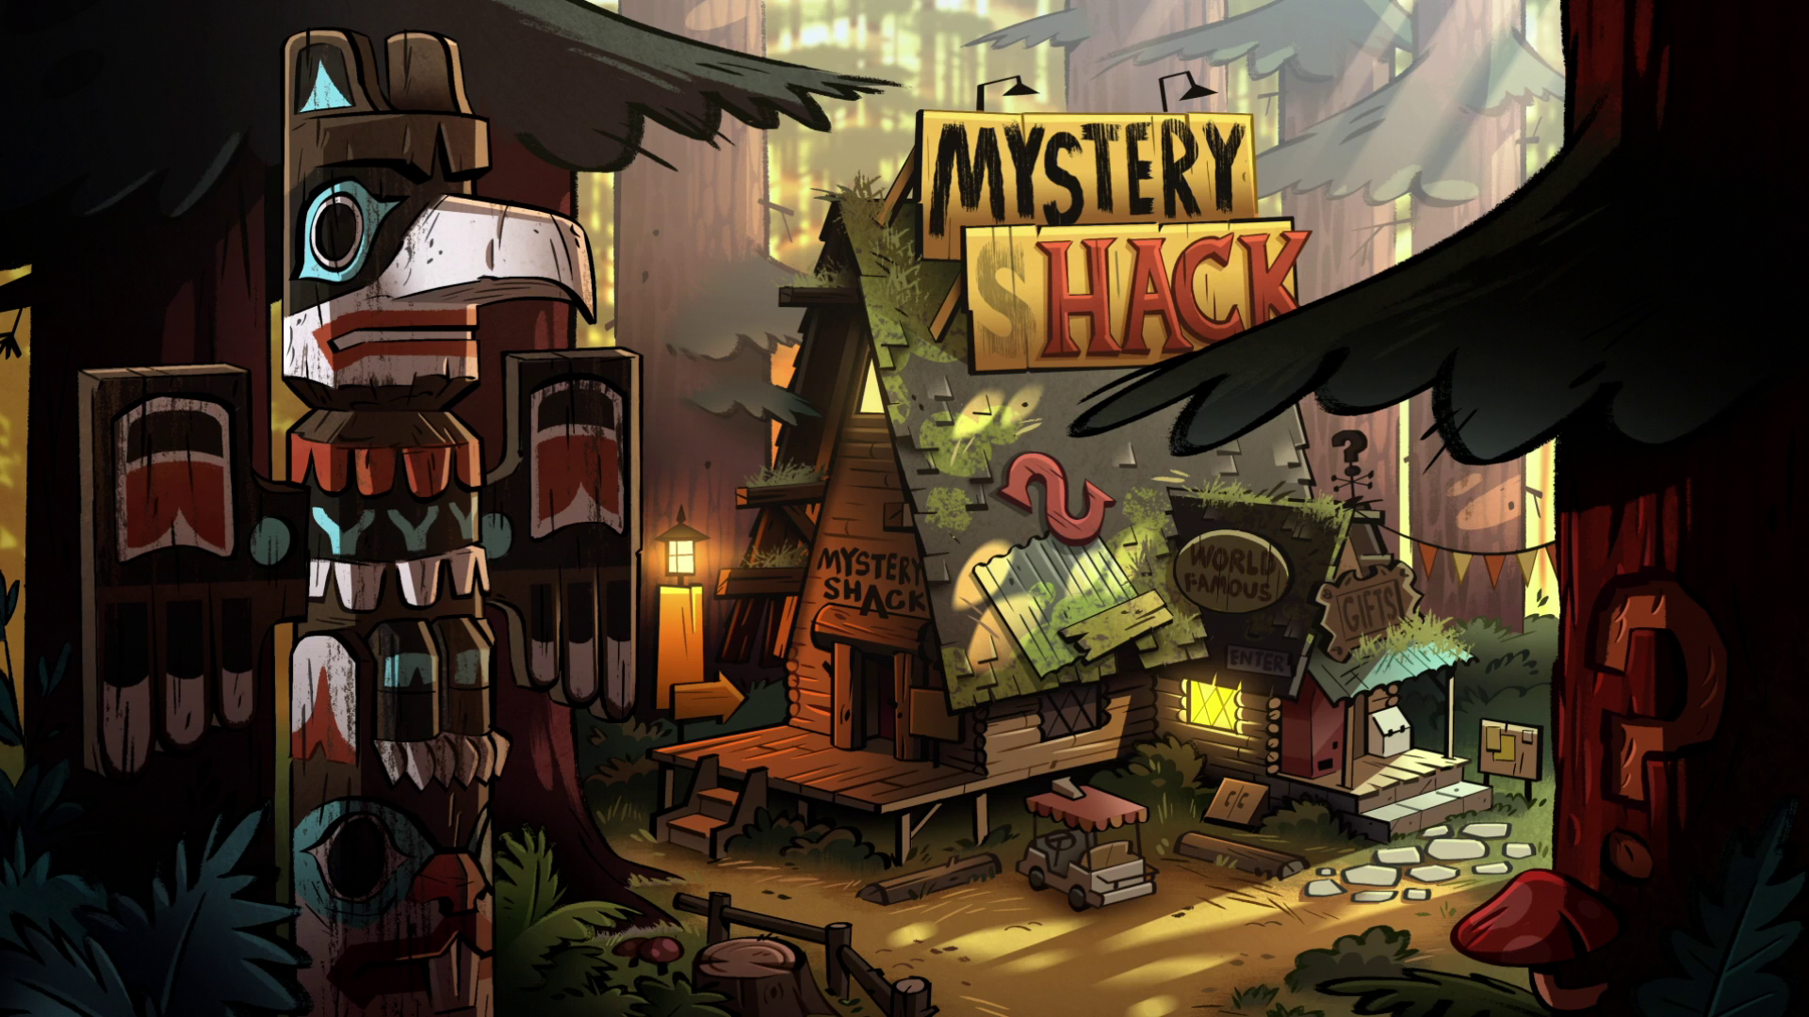
PROJECT DESCRIPTION

Slide 4
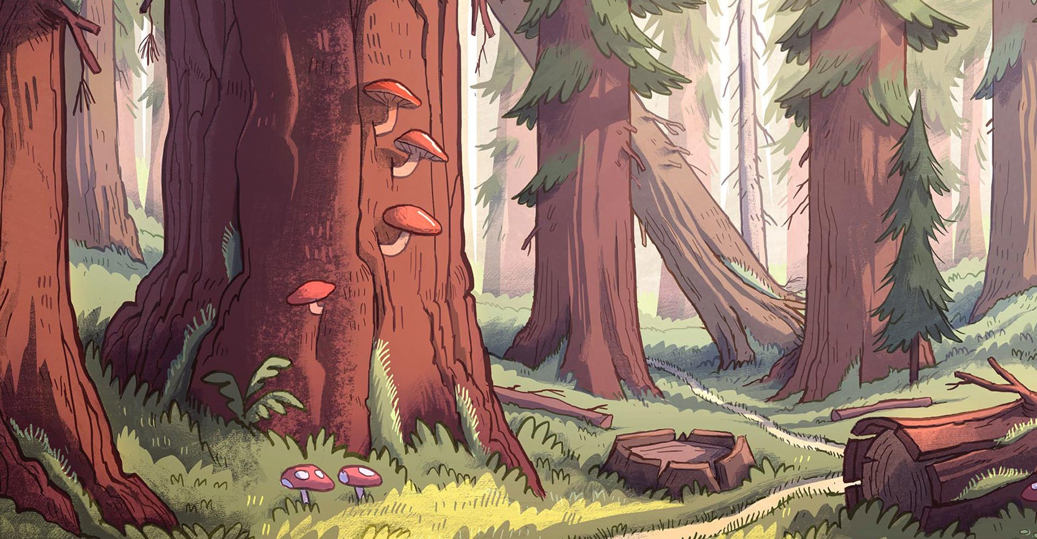
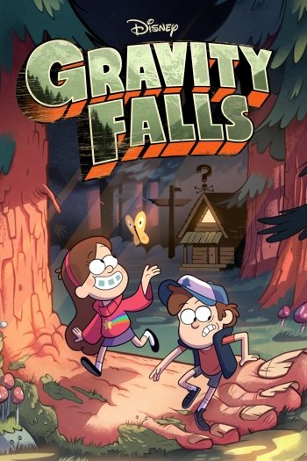
STORY AND BASE ON:
Gravity Falls, is an American animated mystery comedy television series created by Alex Hirsch for Disney Channel and Disney XD.

Slide 5
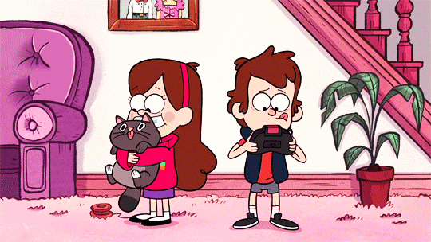
It follows the adventures of twin siblings, Dipper and Mabel Pines. They are sent to spend the summer with their great-uncle Grunkle Stan, while the twins thought this would be just another summer vacation in Gravity Falls, Oregon, Little did they know danger lurks around every corner in little Gravity Falls. But when Dipper found a strange journal in the woods, they learn about some strange secrets about the town. Welcome to Gravity Falls. Just north of Normal, west of Weird.

Slide 6
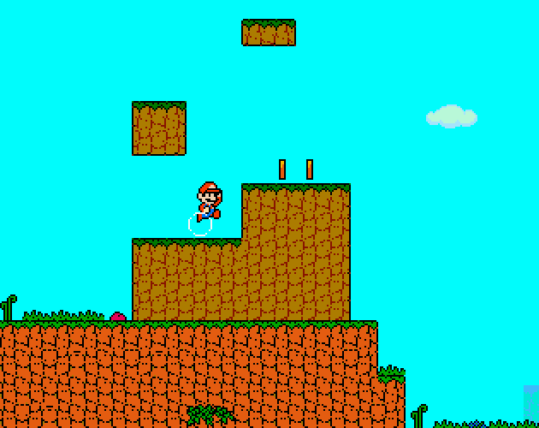
ALGORITHMS:
Super Mario Game is a Japanese platform video game series and media franchise created by Nintendo and featuring their mascot, Mario.
Our Algorithms is based on a platform game, the player runs and jumps across platforms and atop enemies in themed levels.

Slide 7
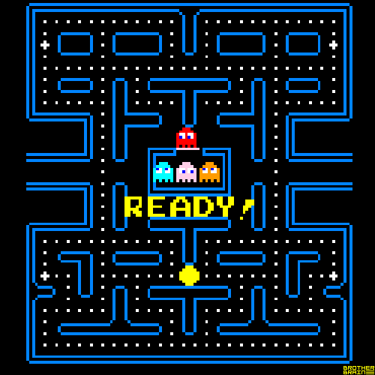
ALGORITHMS:
Pac-Man is an arcade video game that was made by Namco and designed by Toru Iwatani. It was released in 1980, and became very popular in the history of games.
Our Algorithms is based on the collision detection of this game, wherein pacman will collect dots an score will be added.

Slide 8
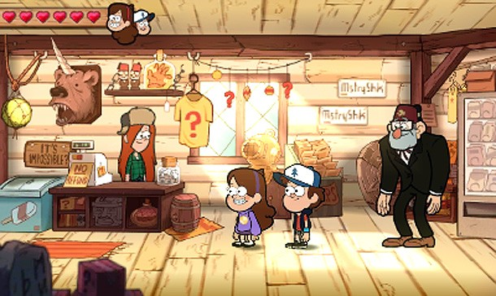
ALGORITHMS:
RPG Game, roleplaying game , in which players assume the roles of characters in a fictional setting.
Our Algorithms, In our game , the player will choose what character she or he will take is it DIPPER PINES or MABEL pines .

Slide 9
GAME DESCRIPTION

Slide 10
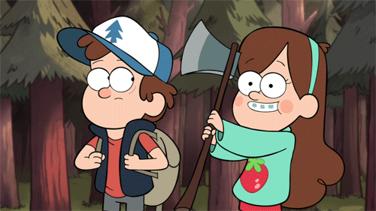
During their stay in the woods, Dipper and her sister found a journal book which tells the secret mysteries of Gravity falls and unravel the different local mysteries happened in the sleepy town. A long their adventure the twin suddenly unleash Bill Cipher and lead the town to chaos. In able to defeat bill they must find the 10 symbols to complete the Zodiac wheel. The goal of the game is for the user to control and help the twins to find the symbols of each person that correlates with a symbol stands in a drawn version of the zodiac wheel.

Slide 11
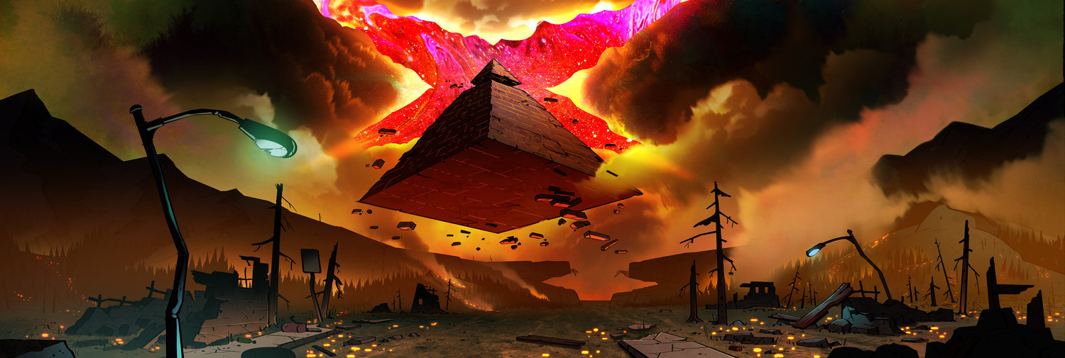
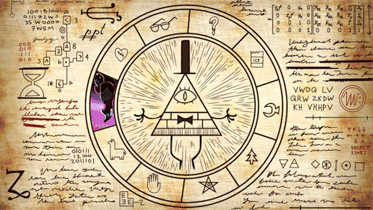
ABOUT THE GAME
Zodiac Symbol, is a symbol associated with Bill Cipher and the symbols surrounding him. It is later revealed that this wheel is a prophecy that can be used to defeat him

Slide 12


ABOUT THE GAME
Mabel Pines, she is a 12-year-old girl She takes a much less serious approach to life than her twin brother as she navigates her way around odd, new surroundings. the second character in the game.

Slide 13

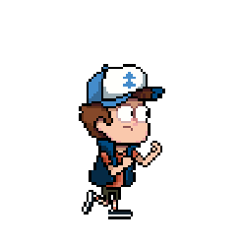
ABOUT THE GAME
Mason "Dipper" Pines, is a smart, curious, and adventurous 12-year-old boy spending the summer with his Great Uncle Stan in Gravity Falls, Oregon, where he and his sister constantly encounter the town's paranormal tendencies. This is the first character of the game.

Slide 14
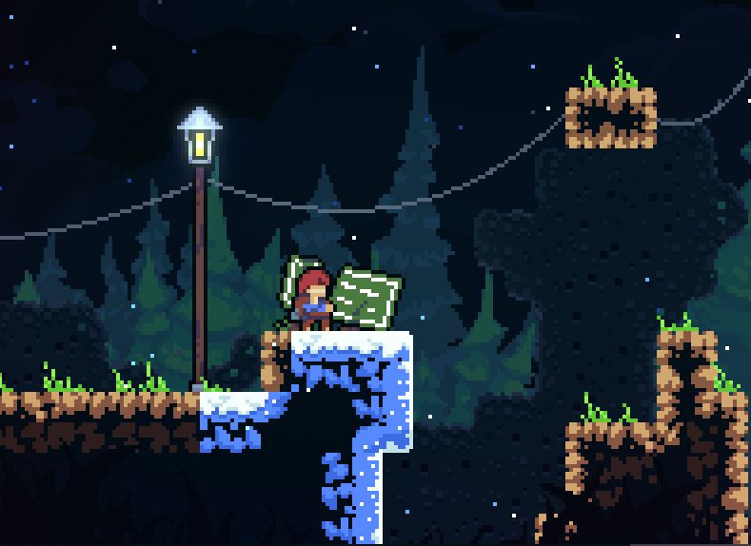
ABOUT THE GAME
Platform games, or platformers, are a video game genre and subgenre of action game. In a platformer, the player controlled character must jump and climb between suspended platforms while avoiding obstacles. Environments often feature uneven terrain of varying height that must be traversed.

Slide 15
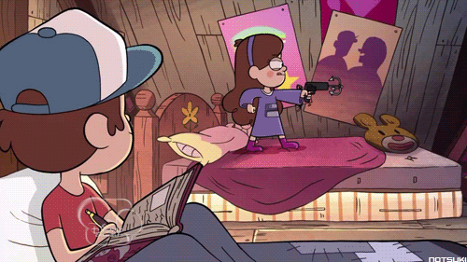
ABOUT THE GAME
Grappling Hook, it is use to collect the symbols and beat the weird monsters.

Slide 16
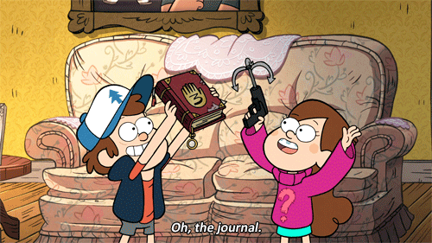
ABOUT THE GAME
Journal books, this will the guide of the twin adventure it consit of 3 journal books which is level 1, level 2, and level 3

Slide 17
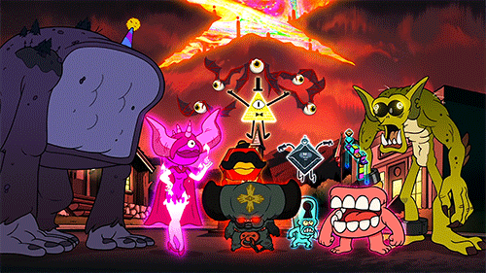
ABOUT THE GAME
Weird Monsters, along their way they will encounter first the different monster before they beat Bill Cipher.

Slide 18
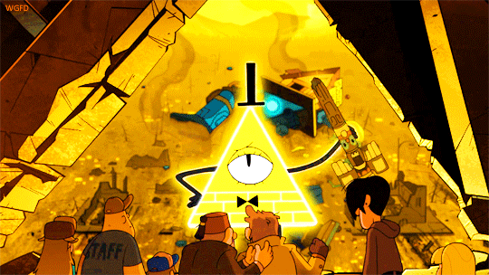
ABOUT THE GAME
Bill Cipher, the boss enemy of the game it is the last level.

Slide 19
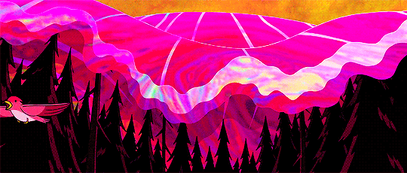

Slide 20
GAMEPLAY

Slide 21
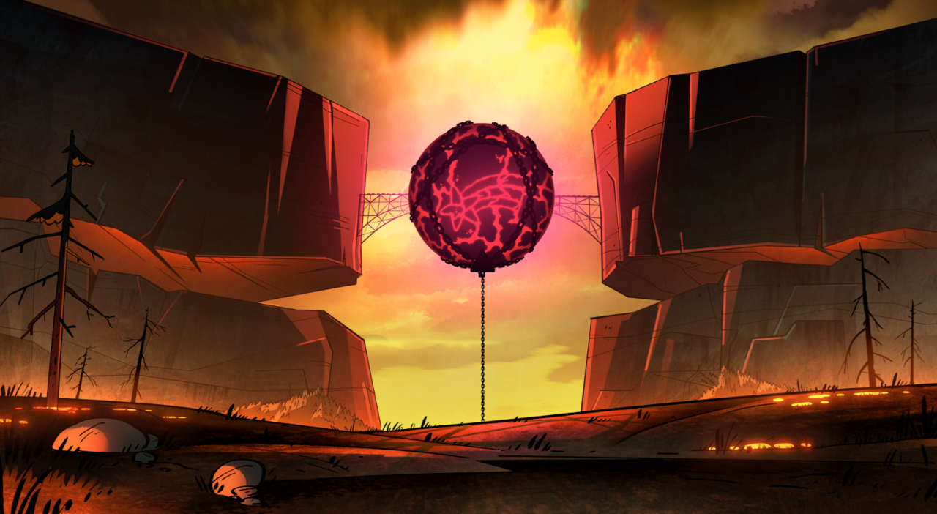

GAMEPLAY
Up, down, left, right keys :
makes the character move
across the panel/map. Will also
go up and down the menu with
the options of:
> START: will go to the panel
and will start the game and the
time.
> EXIT: will exit the game

Slide 22
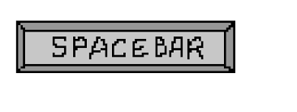
GAMEPLAY
Space : will make the character jump and avoid the enemy

Slide 23
GAMEPLAY
ESC : will pause the game,
and go to the pause menu.
Where it shows how to play
the game. When the
following are pressed:
> Space: will unpause
the game and return back to
the game frame.
> Esc: will return to the
main menu.

Slide 24
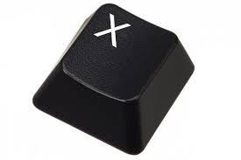
GAMEPLAY
X; it will use to beat the enemy and collect the 10 symbols which with the use of grappling hook.

Slide 25
GAMEPLAY
How to Finish the game:
*There are 3 journal books which represent the level of the game. Therefore on their adventure they must find the remaining journal books.
Level 1 = find the remaining books and fight the different creatures
Level 2 = beat the weird monsters and complete the 10 symbols of zodiac wheel, if the zodiac wheel is complete they will go to the next level which is level 3 and must beat the boss which is Bill cipher.

Slide 26
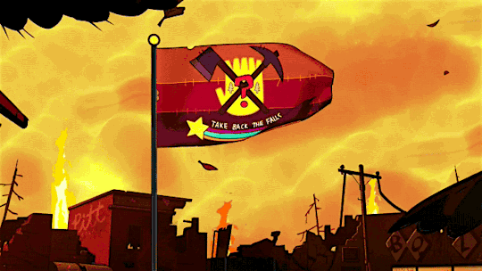

Slide 27
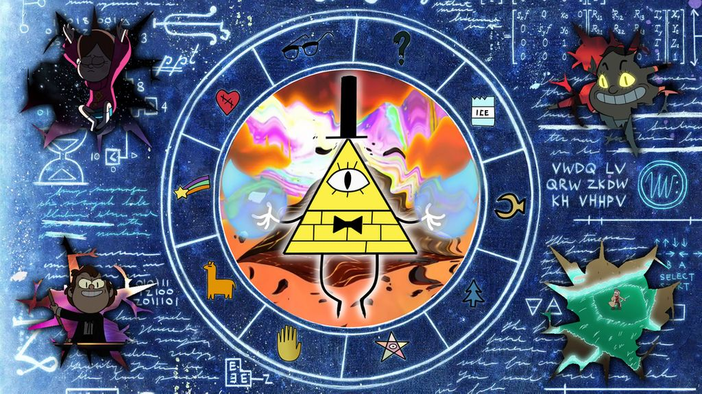
SIGNIFICANT CODES

Slide 28
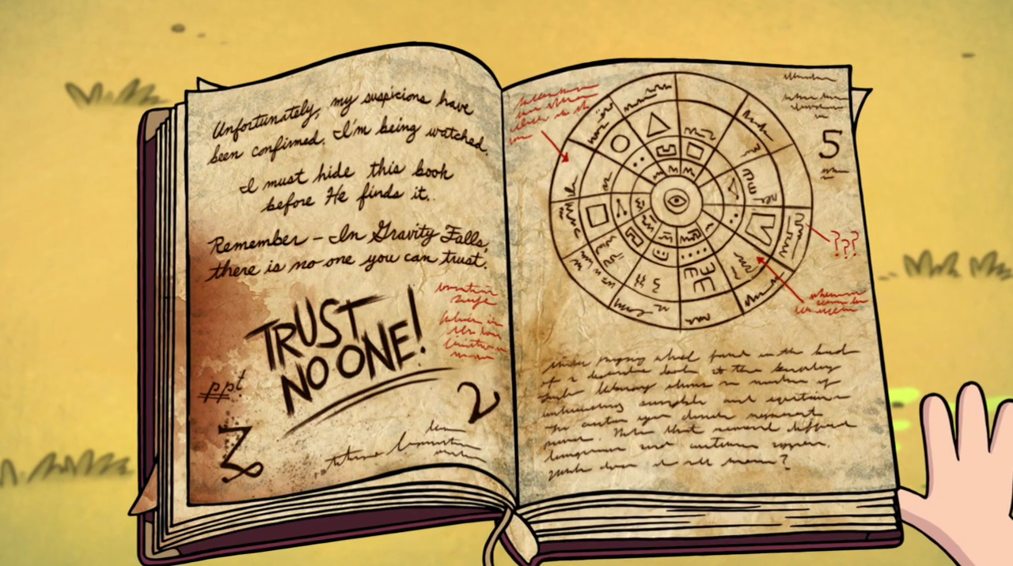
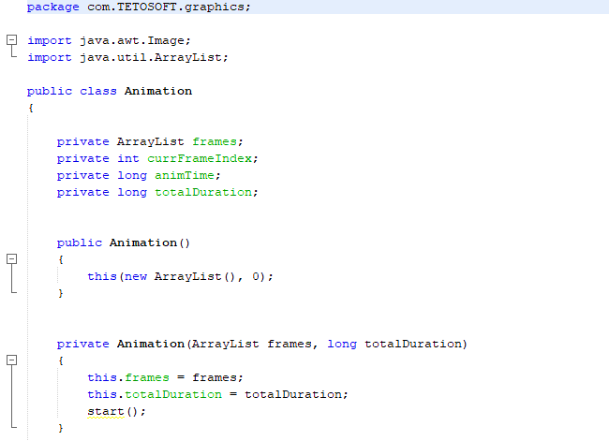
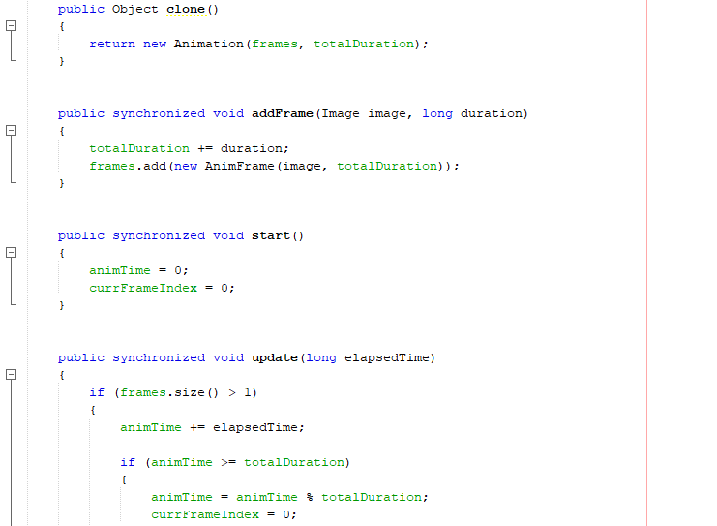
ANIMATION

Slide 29
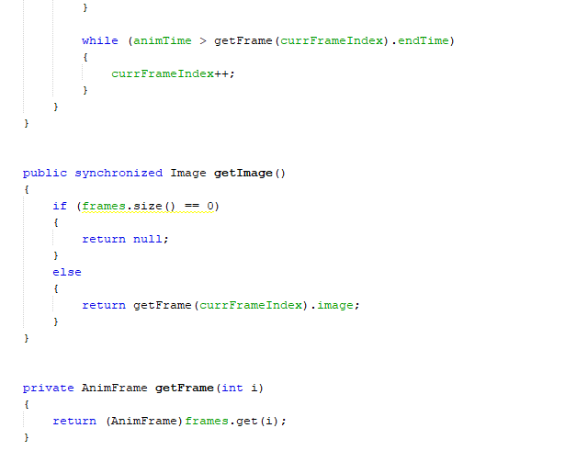
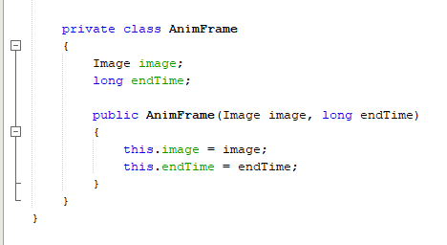
ANIMATION

Slide 30
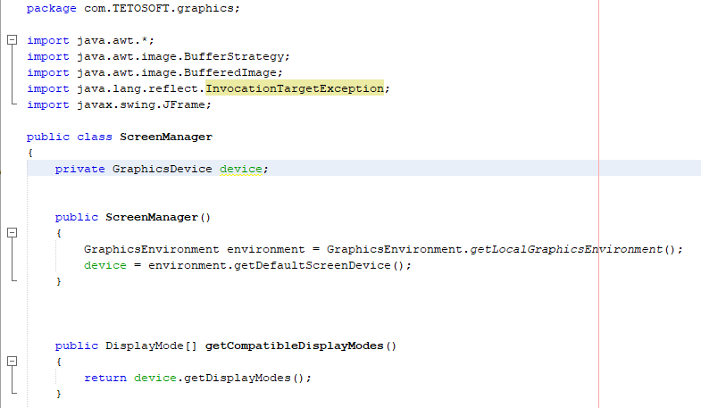
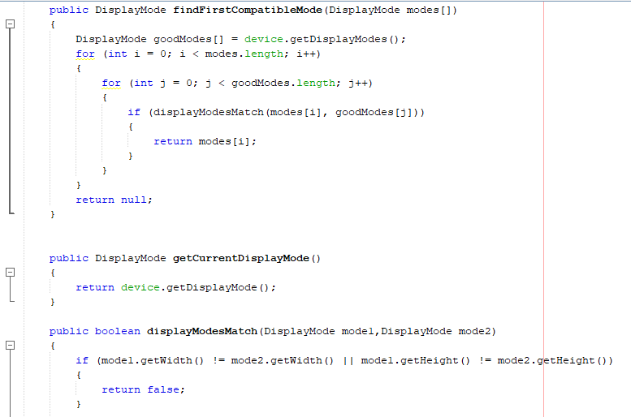
SCREEN MANAGER

Slide 31
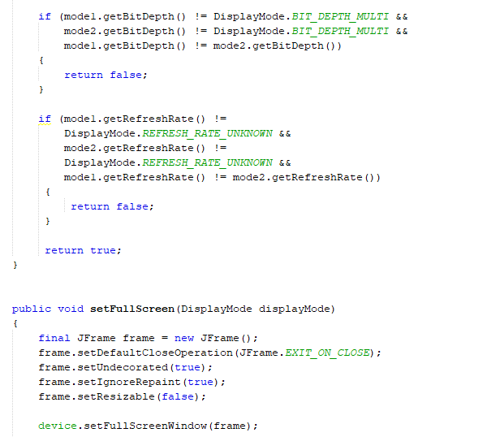
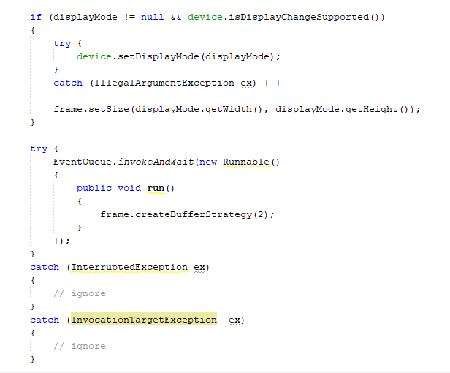
SCREEN MANAGER

Slide 32
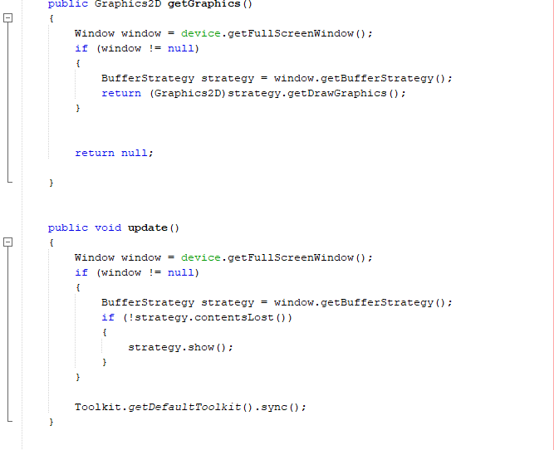
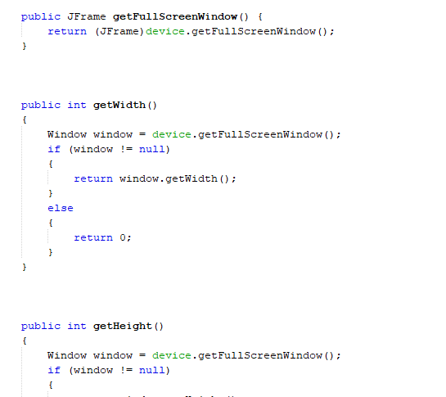
SCREEN MANAGER

Slide 33
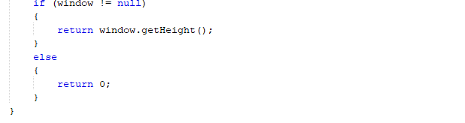
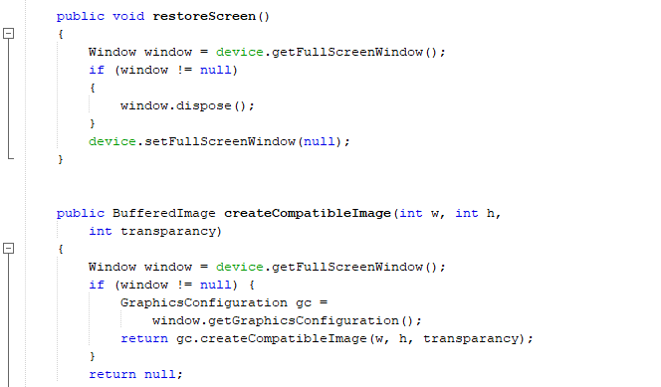
SCREEN MANAGER

Slide 34
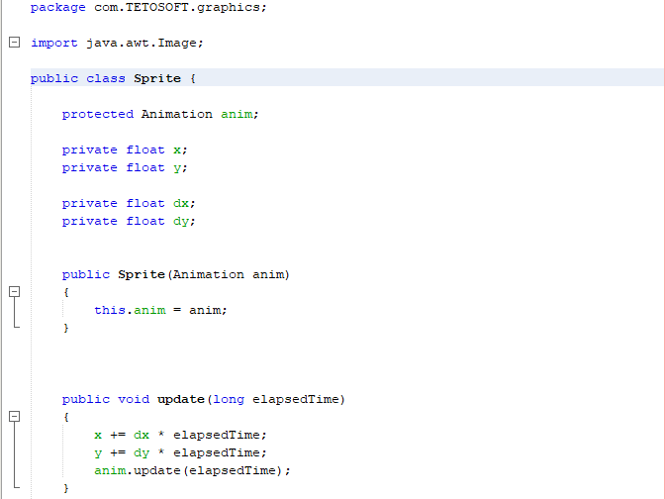
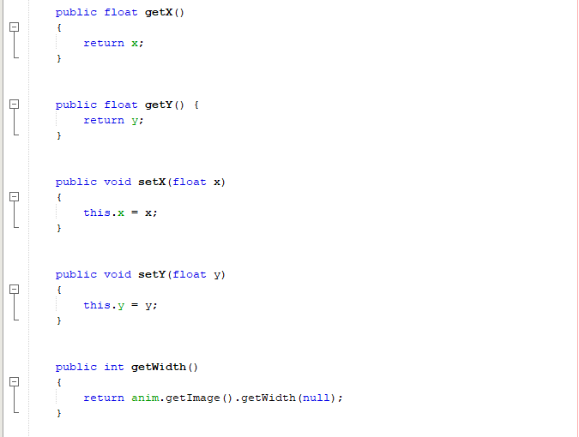
SPRITE

Slide 35
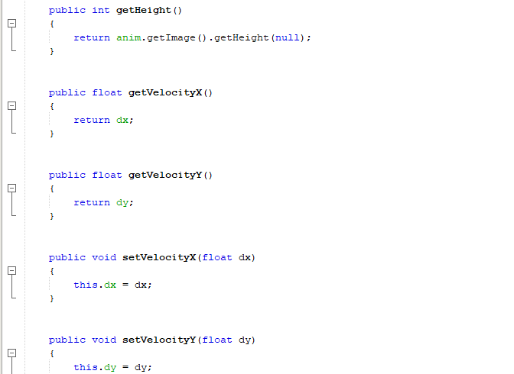
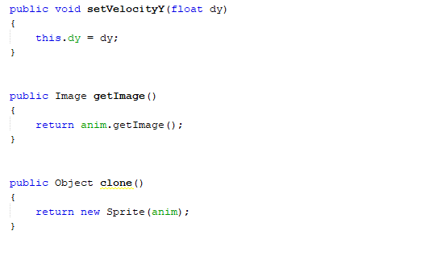
SPRITE

Slide 36
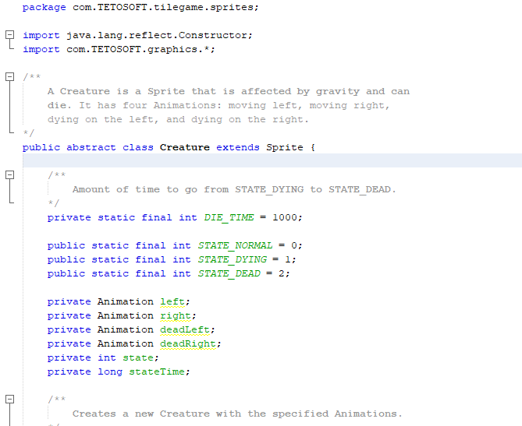
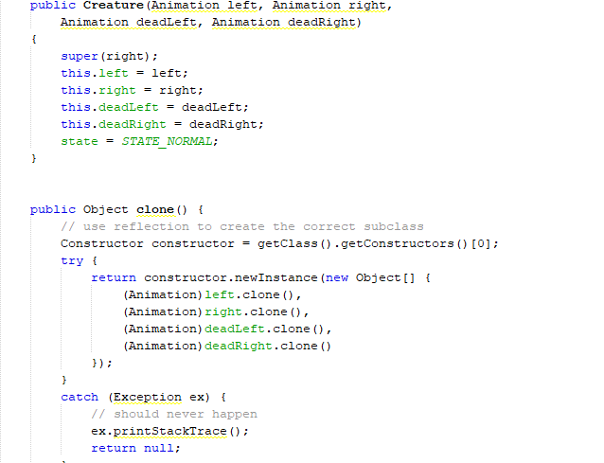
CREATURE

Slide 37
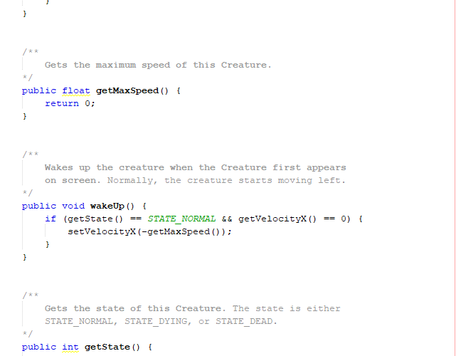
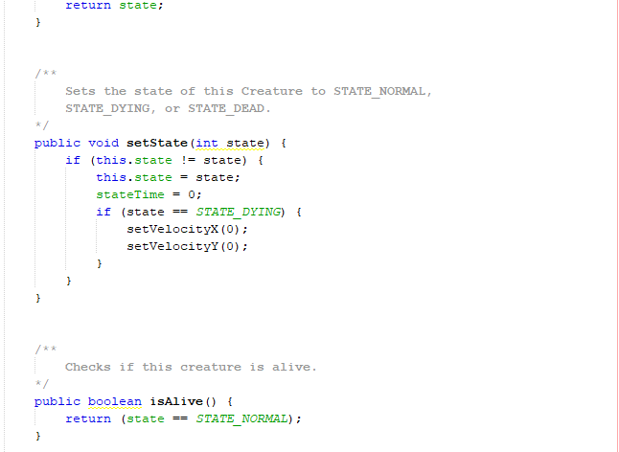
CREATURE

Slide 38
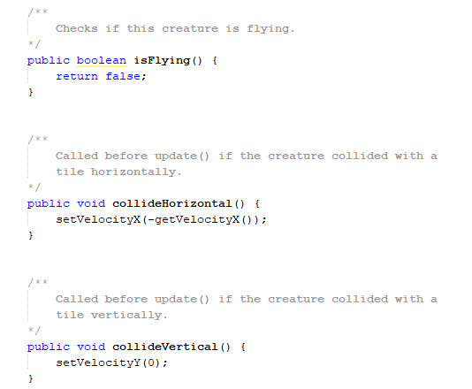
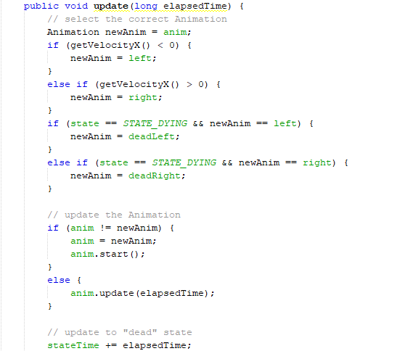
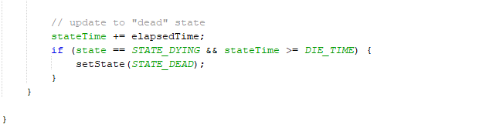
CREATURE

Slide 39
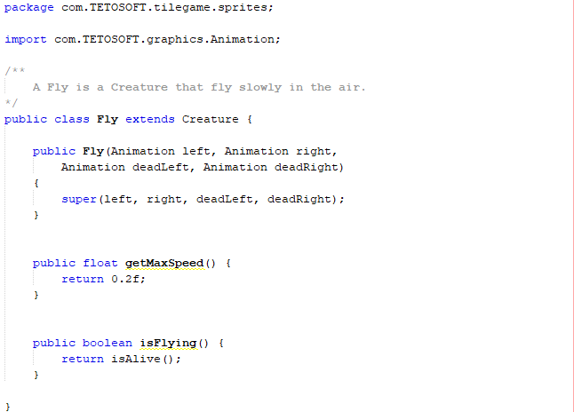
FLY

Slide 40
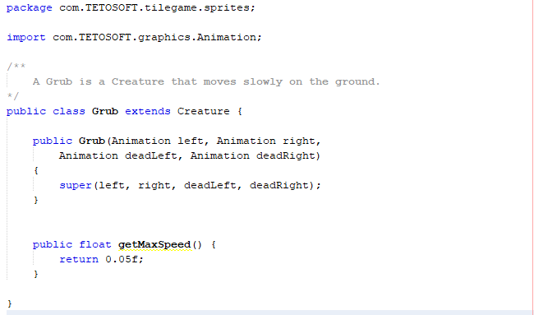
GRUB

Slide 41



PLAYER

Slide 42

POWER UP

Slide 43



GAME ENGINE

Slide 44


GAME ENGINE

Slide 45


GAME ENGINE

Slide 46


GAME ENGINE

Slide 47


GAME ENGINE

Slide 48


GAME ENGINE

Slide 49


MAPLOADER

Slide 50


MAPLOADER

Slide 51


MAPLOADER

Slide 52


MAPLOADER

Slide 53


MAPLOADER

Slide 54


MAPLOADER

Slide 55


MAPLOADER

Slide 56


TILEMAP

Slide 57


TILEMAP

Slide 58


TILE MAP DRAWER

Slide 59


TILE MAP DRAWER

Slide 60


TILE MAP DRAWER

Slide 61


Slide 62
SOURCE CODE:
https://github.com/mtala3t/Super-Mario-Java-2D-Game
GITHUB LINK:
https://github.com/trishyAusten/Gravity_Falls_Game.git

Slide 63
MEMBERS
Pagtulingan, Trisha
Vermon, Daniela
Cawal-o, Keziah
Bulayo, Mariel
SECTION
CITCS 1G

